Slide 1

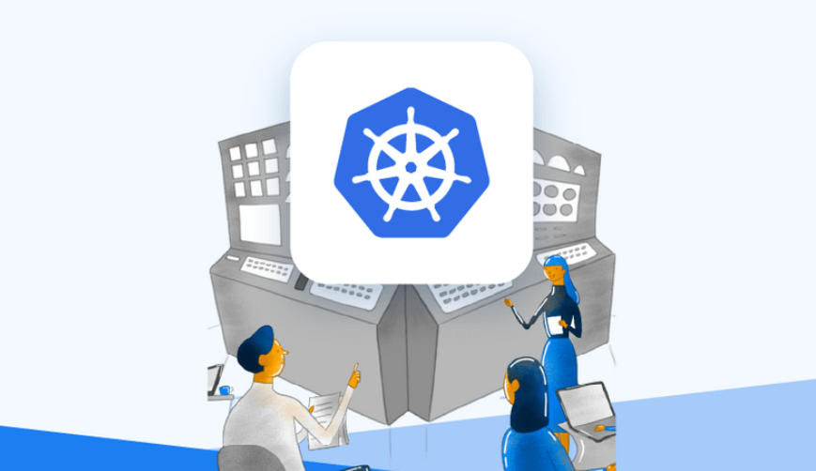
Services
School of Kubernetes
Blog
Our team
References
Join
the world of Kubernetes

Slide 2

Services
School of Kubernetes
Blog
Our team
References
Kubernetes Installation
Kubernetes Maintenance
Performance Tunning
Enterprise Consluting
API Management & Designing
CI/CD
Observability, Logging, Monitoring, Tracing
SDLC
Public Cloud Deployment
Join
the world of Kubernetes

Slide 3

I represent the synergy of several segments:

Slide 4

Hello guys,
I am Rubic / K8s and I belong to Kubernetes family. Within following pages, I will present myself and explain:
Who am I?
Which are the services embedded in our offer?
Who is the team which will assist us in creating perfect infra orchestra?

Slide 5
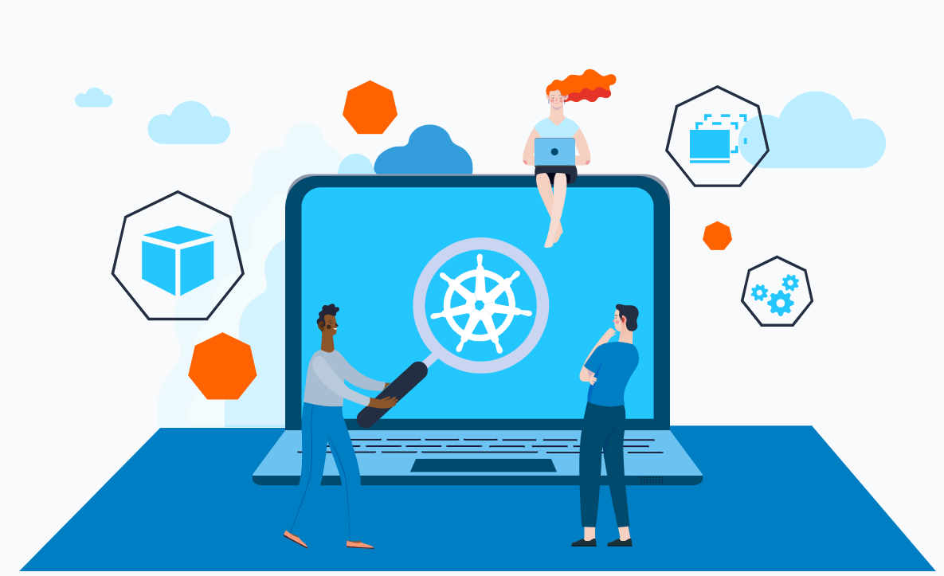
Installation
Installing Kubernetes clusters on-premises and in the cloud, using a variety of deployment methods, such as kubeadm, kops, Rancher, Kubermatic, etc, is core. Installation is done in a secure and scalable manner, taking into account your business requirements and infrastructure.

Slide 6
Maintenance & Performance tuning
We provide ongoing maintenance and performance tuning services to ensure that your Kubernetes environment is running optimally. Our team monitors your Kubernetes infrastructure, identifies and resolves issues, and implements best practices to ensure optimal performance, scalability, and security.

Slide 7
On-premise Management
We have experience managing Kubernetes clusters on-premises, ensuring that the installation and management is done in a secure, scalable, and highly available manner. Our team provides ongoing support to ensure that your on-premises Kubernetes infrastructure is running optimally.

Slide 8
GitOps & Infrastructure management
We can also help businesses implement GitOps to manage their Kubernetes infrastructure. We use Git as the single source of truth for infrastructure and application configurations, making it easy to manage changes and rollbacks across environments.

Slide 9
Infrastructure as a Code
Our team can help businesses implement Infrastructure as Code (IaC) to manage their Kubernetes infrastructure. We use tools like Terraform and Crossplane to automate the deployment and management of Kubernetes clusters, ensuring consistency and reliability across environments

Slide 10
Kubernetes
Consulting
We offer Kubernetes enterprise consulting services to help businesses in making the most of their Kubernetes infrastructure. Our consultants provide expert guidance and support throughout the implementation and management process, helping businesses design and implement their Kubernetes infrastructure to meet their specific needs and requirements.

Slide 11
To be continued

